Slide 1
Goals for today:
Use Git/Github to version control your code
Contribute to group code efforts
Clone a public code repository and submit your suggested revisions

Slide 2
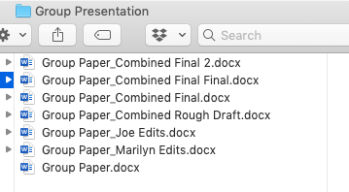
Why version control?
Your folders look like this -->
Add 1 feature, break everything “time machine”
Informative comments and differences between versions
Try a new idea out without losing place
Collaborative coding: I work on section, you work on other
Reproducible code with a DOI (citations)
Open code that collaborators can use and improve

Slide 3


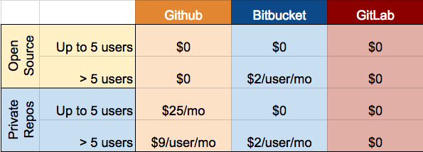
vs
Service
Hosted on web
Online space to hold git repository
One of many options (bitbucket, gitlab), but by far most common
Software
Installed locally
Version control tool
Do I have to use Github to use Git? No

Slide 4
General Idea
“Git allows groups of people to work on the same documents at the same time, and without stepping on each other’s toes.”

Slide 5
Typical workflow: Local computer
Do some work !!
git add
Analogous to a file save.
Snapshot of all files in directory.
git commit
Commits have more info:
Date/time stamp
Commit message
Unique identifier
Local Repo(sitory)

Slide 6
New terminology
Commit: Snapshot of files at a given time Records the time, “track changes” from previous commit, and a unique identifier “I just made a new commit” (noun) or “I committed my code” (verb) Repository: shortened to “repo” Collection of all files and history of the files (commits) Can be on your local machine or remote server (github)

Slide 7
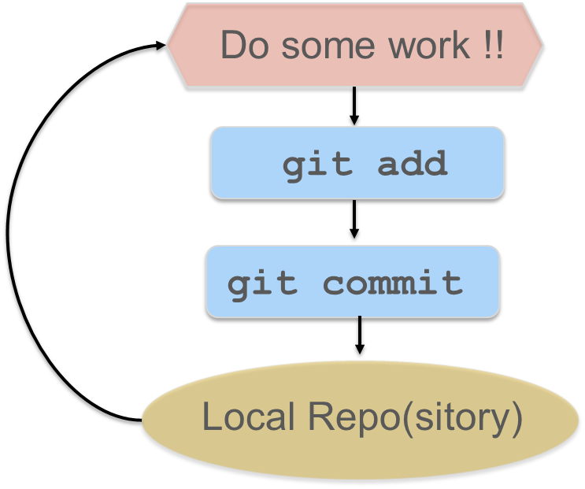
Commits
Commits are “cheap”. Do them often.
You provide a one-line message stating what you did.
git add . git commit –m “Changed precip matrix to array” git add . git commit –m “Fixed precip var name”

Slide 8
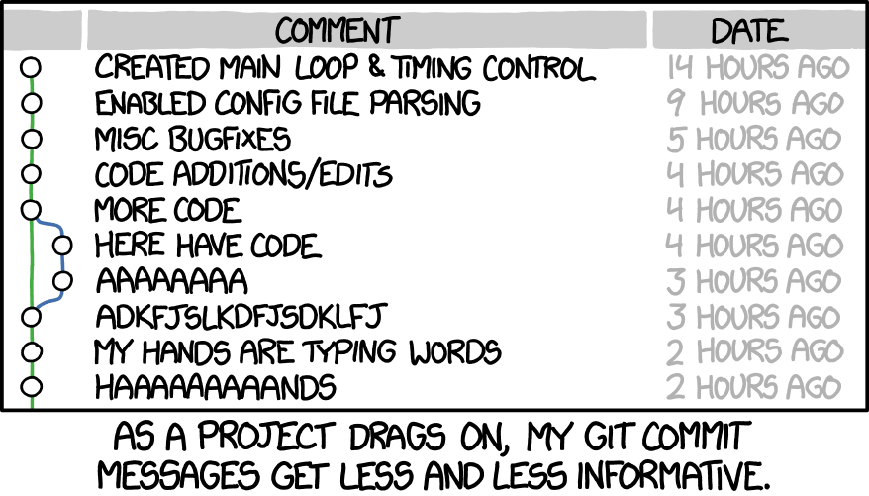
Commit Messages
Commit messages are critical for yourself and other people. Make them useful!
Use them to roll back changes
https://xkcd.com/1296/

Slide 9
Initial Setup
Define yourself as a user. Only have to do this once.
You can use different name/email for a specific project by leaving off the --global
git version
git config --global user.email "you@example.com"
git config --global user.name “Your git username"

Slide 10
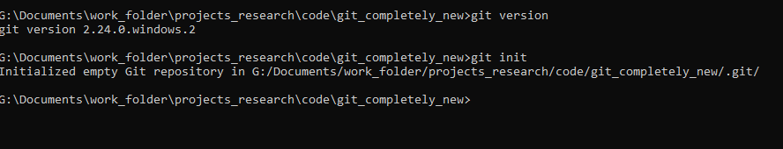
Our first repository
Create a new directory on your computer
Open cmd line (Windows) or terminal (Linux) and move to folder
Create a new repository for git to track
git init

Slide 11
Stage and make the initial commit
Create a new file: code1.R
Add some lines of code to this file
Add and commit this change (with informative message!)
git add .
git commit –m “Initial commit”
Make another change to your file, add, and commit.

Slide 12
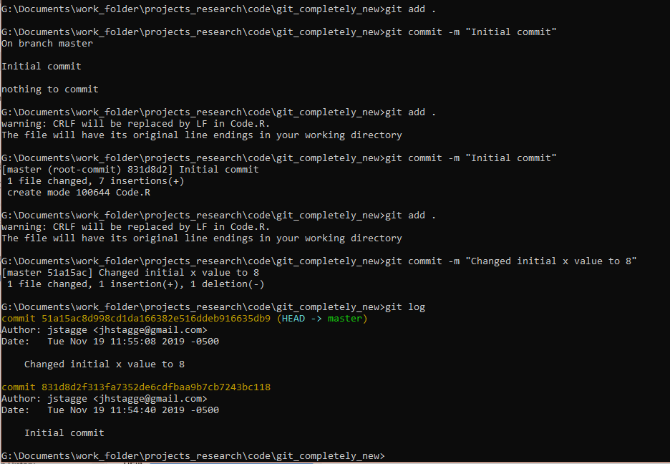
Checking the progress
git log
git status

Slide 13
Reverting back to previous version
You can revert to a previous version using the reset command:
git reset --hard <hash>
Careful – reset will delete the recent work completely
There is another command <revert>, which is slightly softer, but more complex. Honestly, it’s beyond my ability.

Slide 14
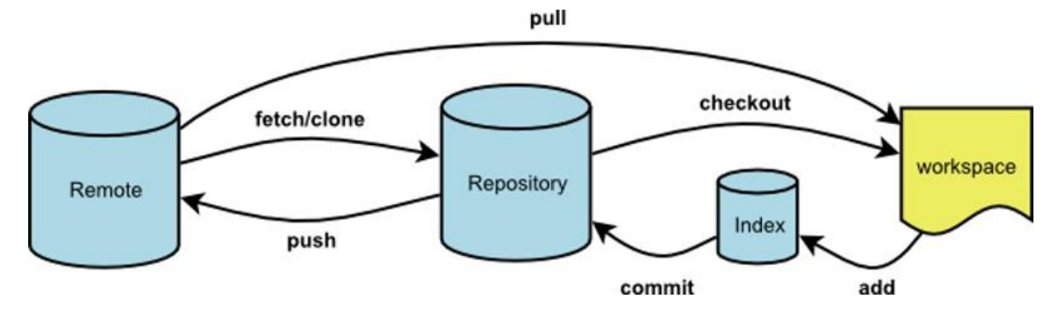
Workflow: incorporating Github
Github website
Your personal computer

Slide 15
New Terminology
Cloning: copying a repository from a remote server
Pull: download new commits from remote repository (Github)
Push: adding local changes to the remote repository (Github)
Branch: all commits live on a branch. Could be 1 or 1,000 Main branch is called the master branch.

Slide 16
Typical personal workflow with Github
Do some work
Repeat regularly and ad infinitum. Like doing a save.
When you’ve made significant progress, e.g. Version 1.2 Push the code to the Github website
git add .
git commit –m “Message goes here”
git push

Slide 17
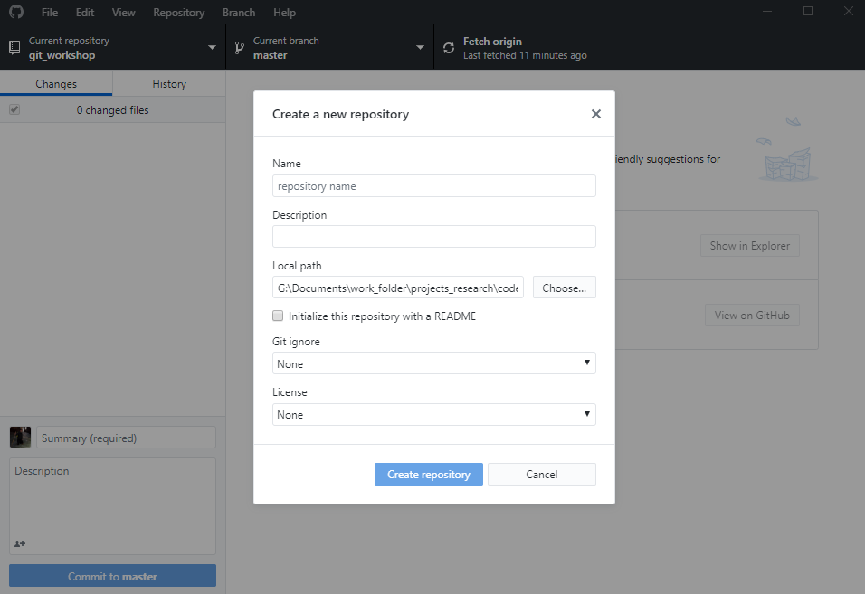
Let’s create a repository with Github Desktop
File -> Create a new repository
Local path
README
Ignore
License
Publish to Github

Slide 18
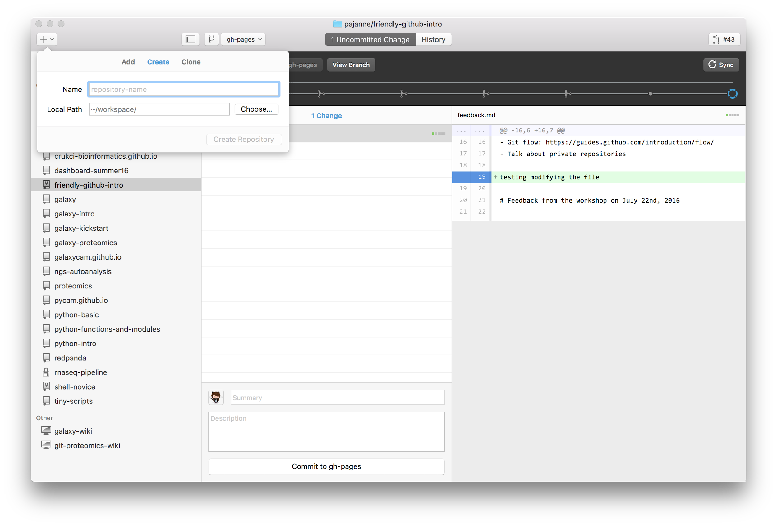
Clone from GitHub
Add an existing directory as a new repo
Create a new repo

Slide 19
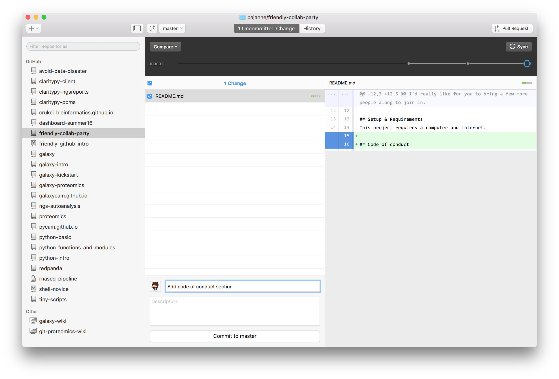
Commit and publish a change

Slide 20
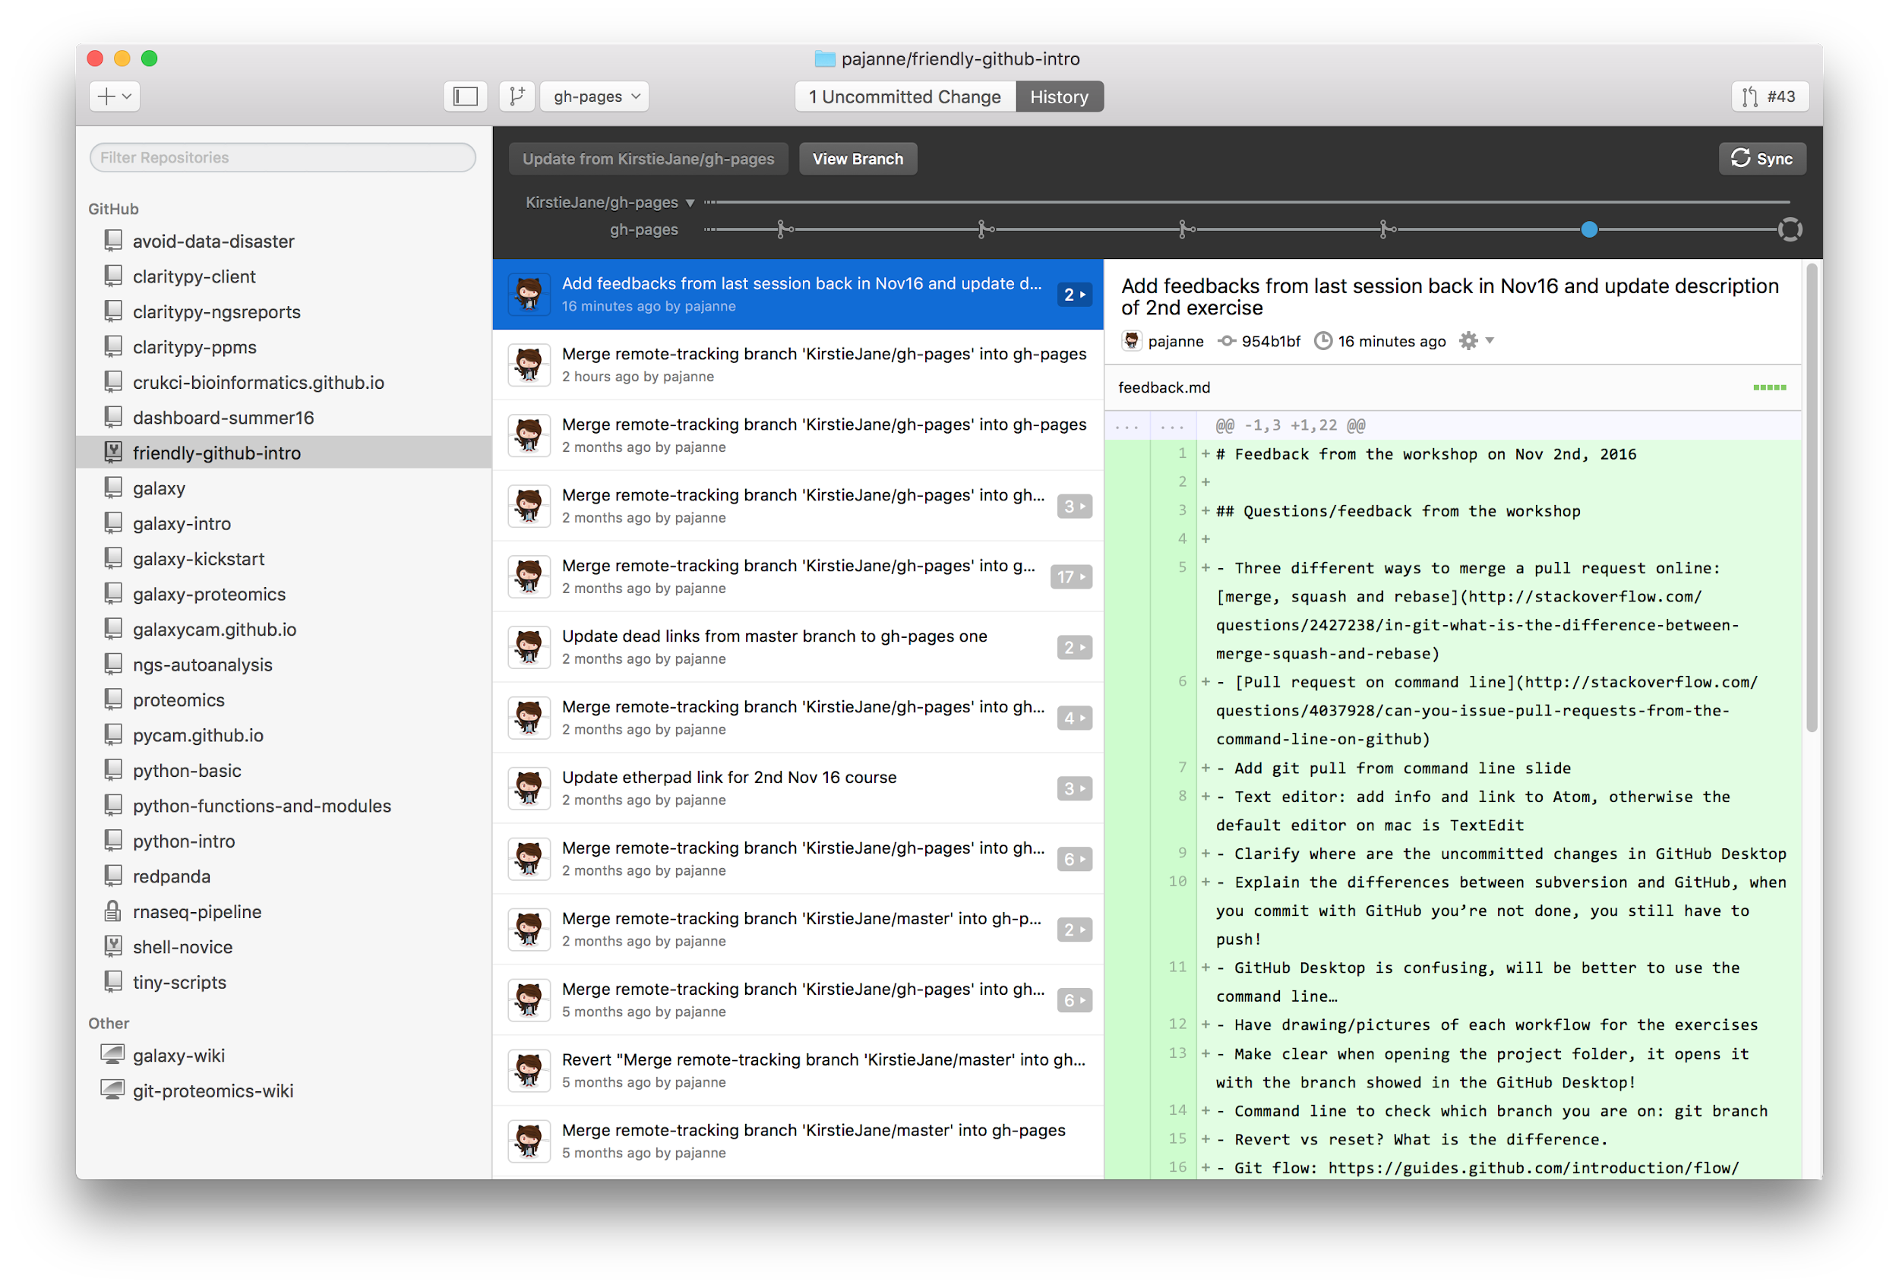
GitHub Desktop
history
timeline
History of commits
repositories
history of commits
changes per commit

Slide 21
Using the command line
> git command arguments
> git clone repo
> git status
> git add changed_file
> git commit -m “message”
> git push
> git checkout -b cmd-line-branch
> git branch
> git push origin cmd-line-branch
> git checkout master
> git branch
> git merge cmd-line-branch
> git push
> git log
> git revert commit_id
> git push

Slide 22
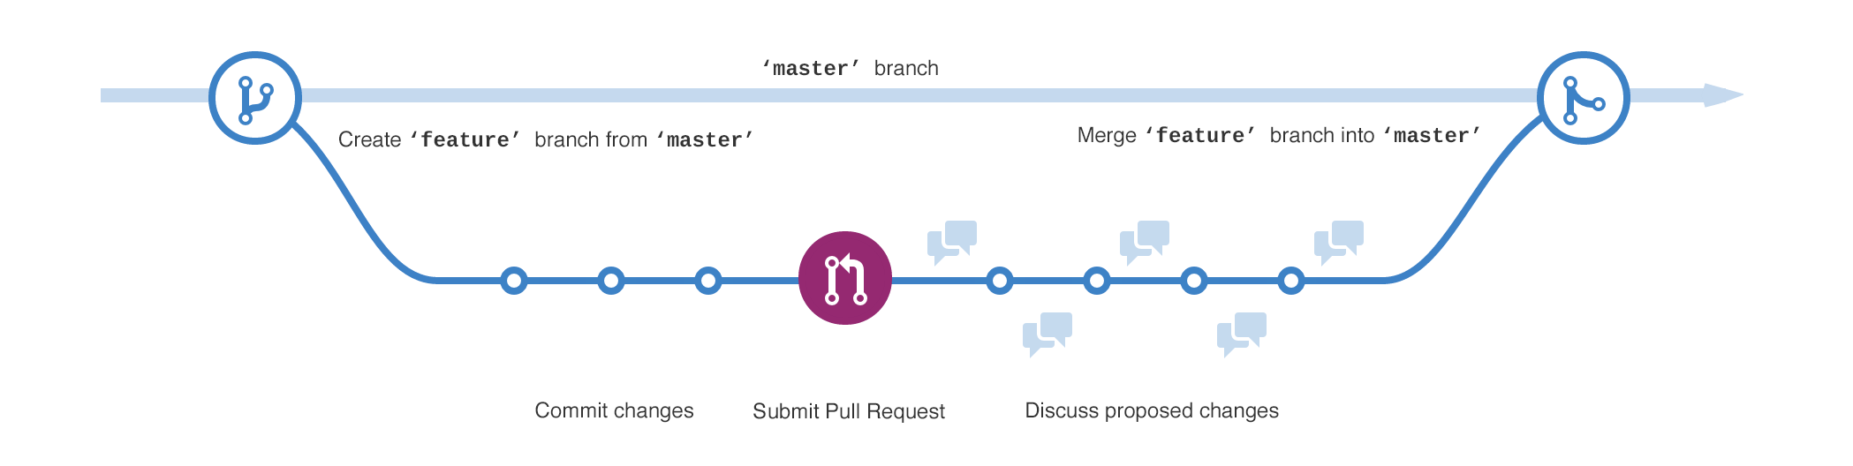
Branches
A branch is a parallel version of the main line of development (master)
Used to:
Develop features
Fix bugs
Safely experiment with new ideas

Slide 23
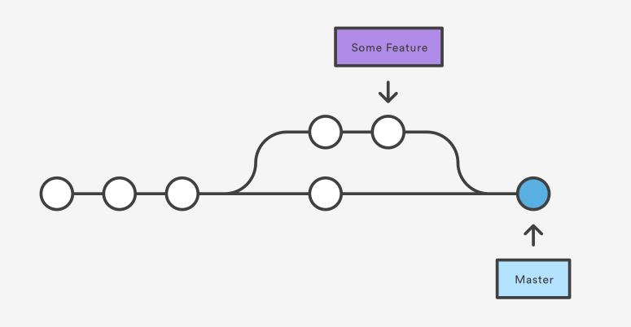
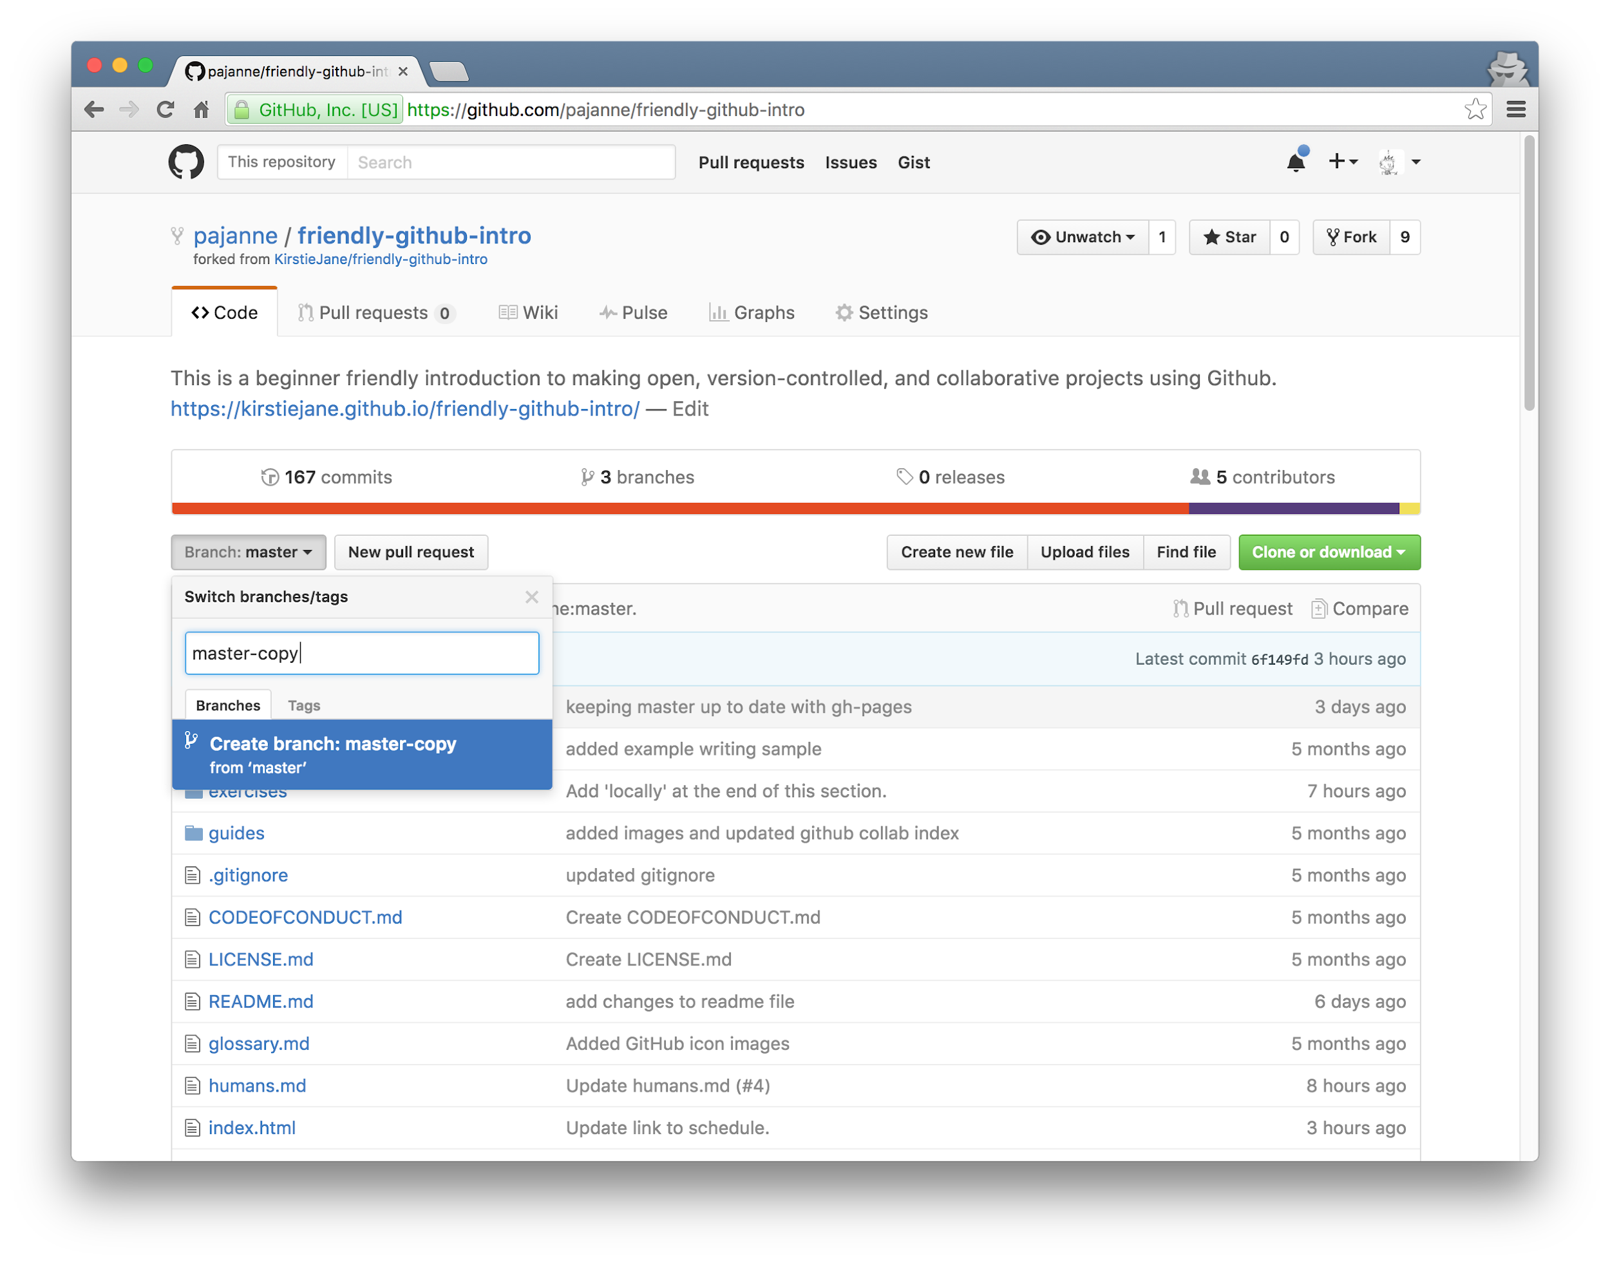
Git/GitHub Terms (2)
Branch
Copy of your project
Pull request
request to add your changes from a branch back into master
Merge
act of incorporating new changes (commits) from one branch to another
https://www.atlassian.com/git/tutorials/using-branches/git-merge

Slide 24
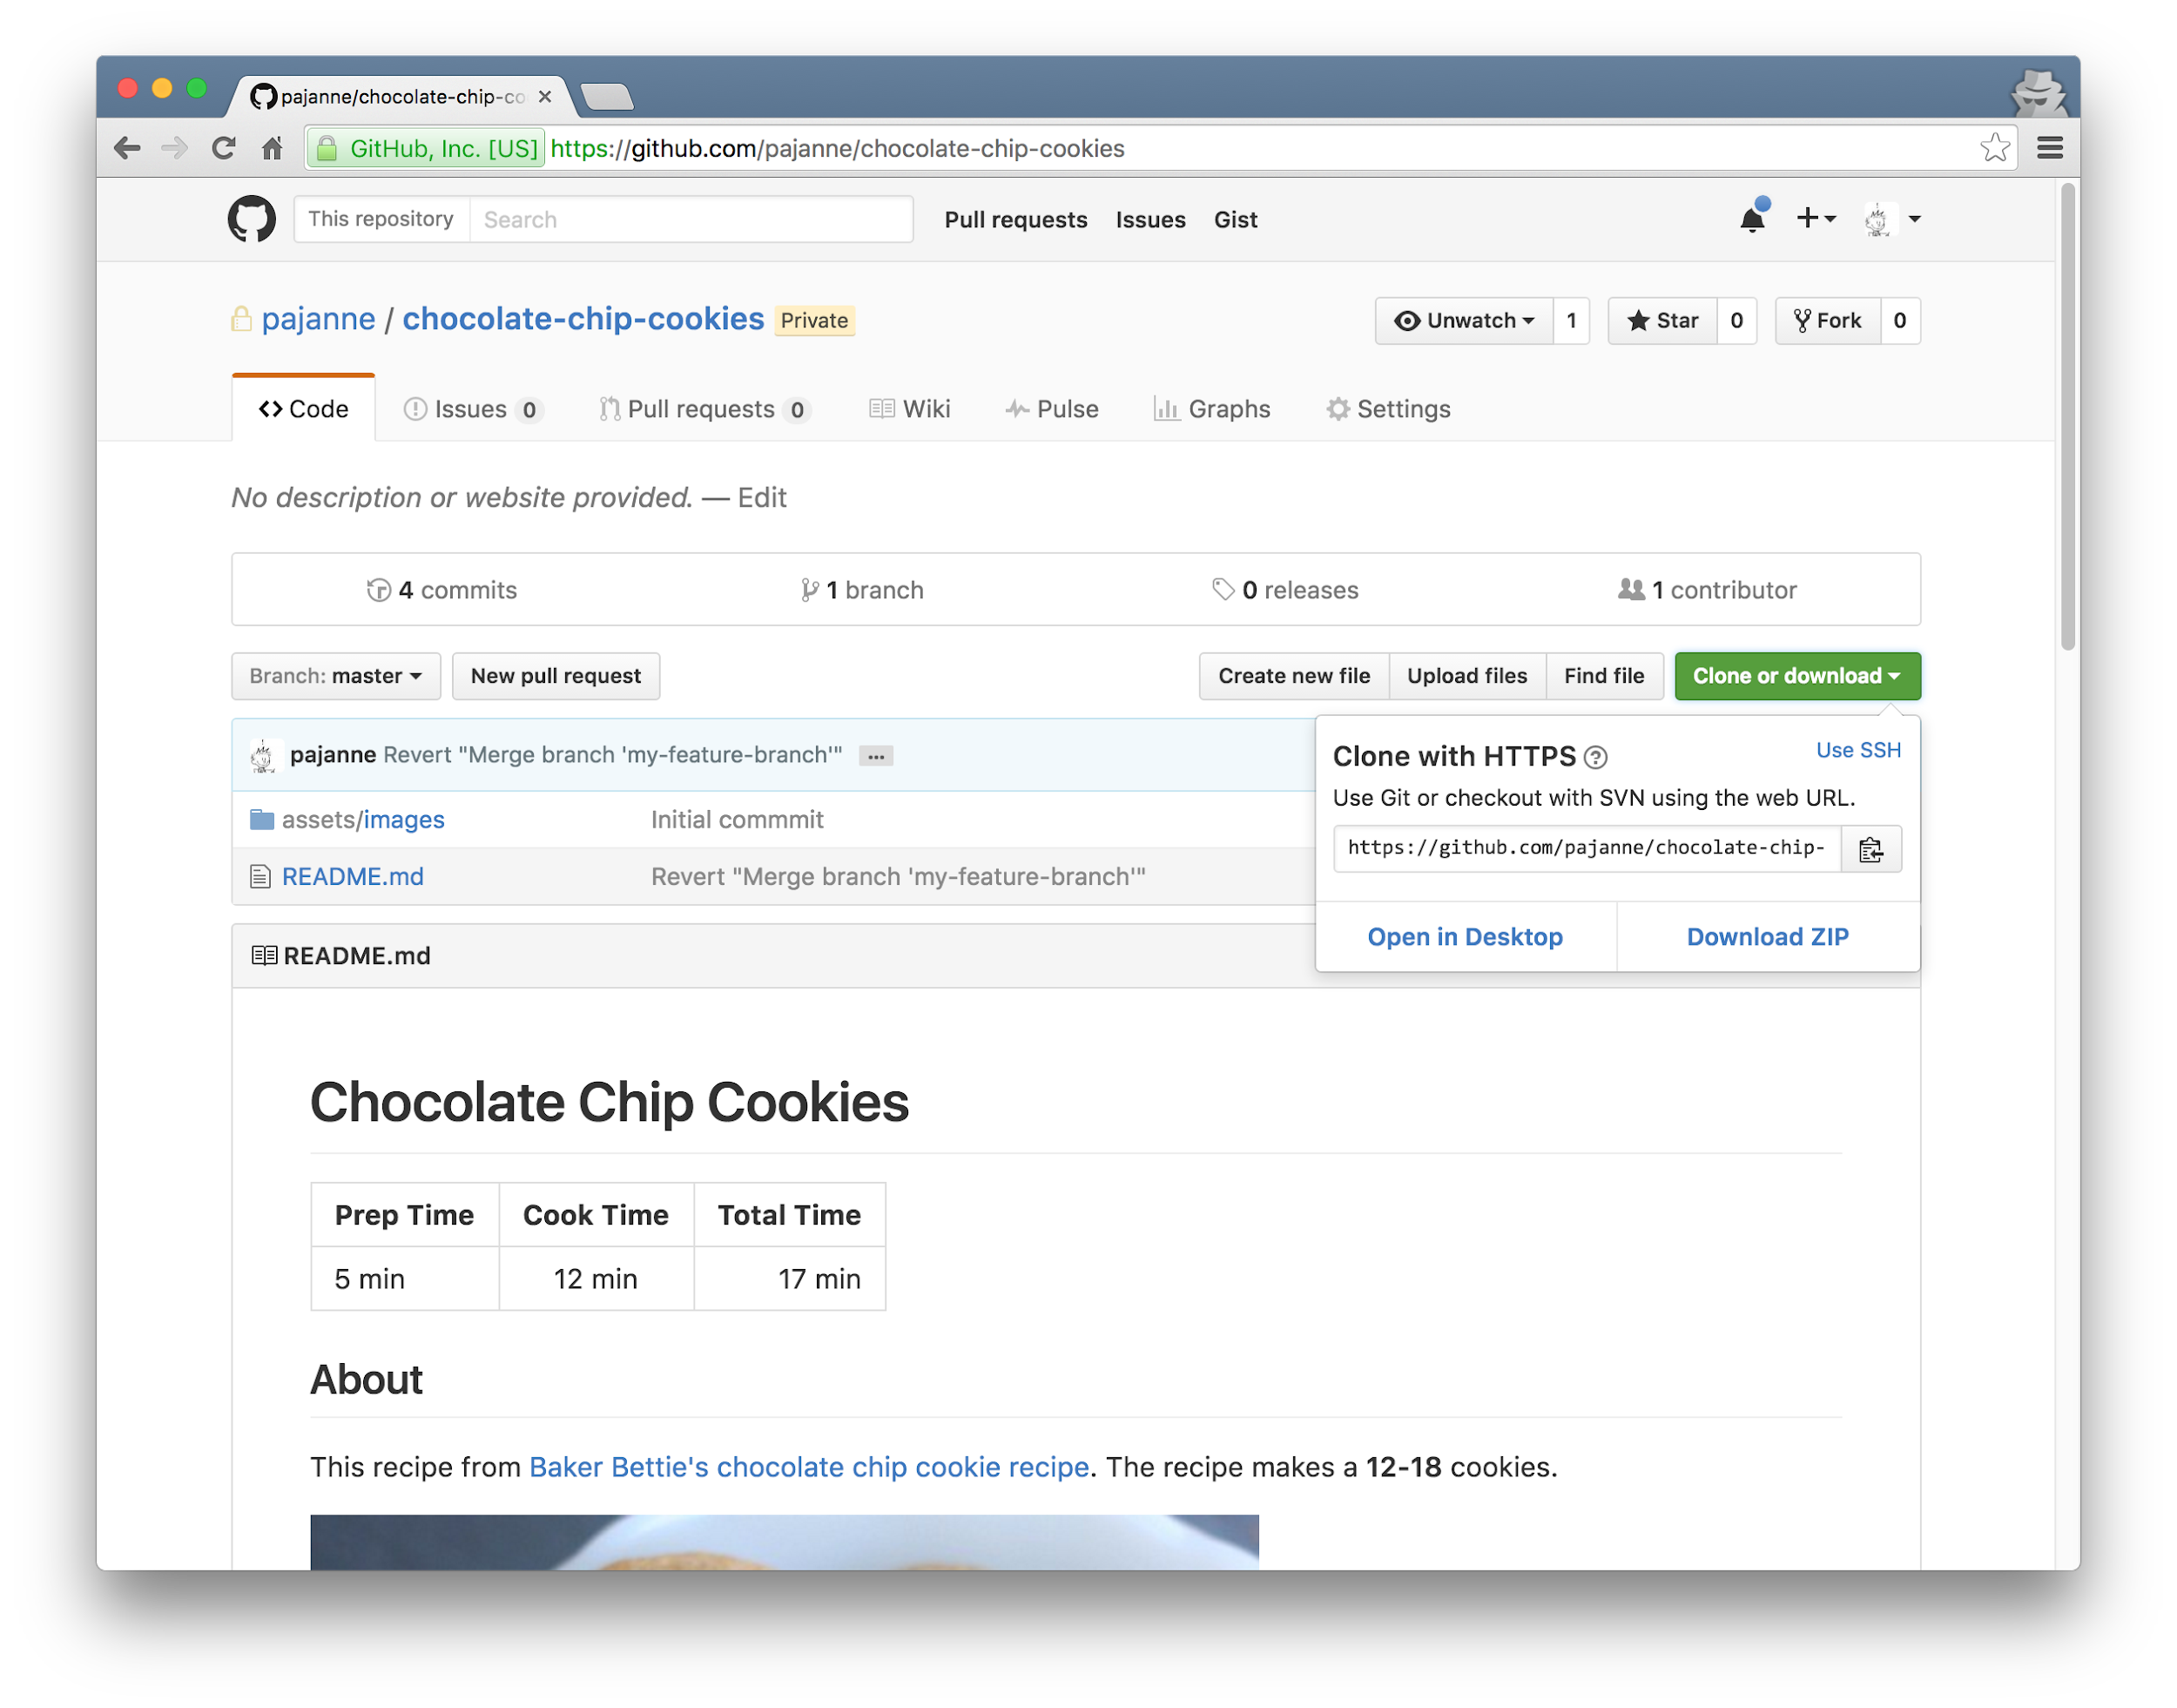
Pull Request to add your changes into forked repo
Fork this repo
Create & manage “Issues”
Your default branch is “master” - but you can switch or add branches here
Clone to your computer from the web using GitHub Desktop or git command
The “README.md” is automatically rendered when you visit a repo
Download Zip to download the zipped repo onto your computer

Slide 25
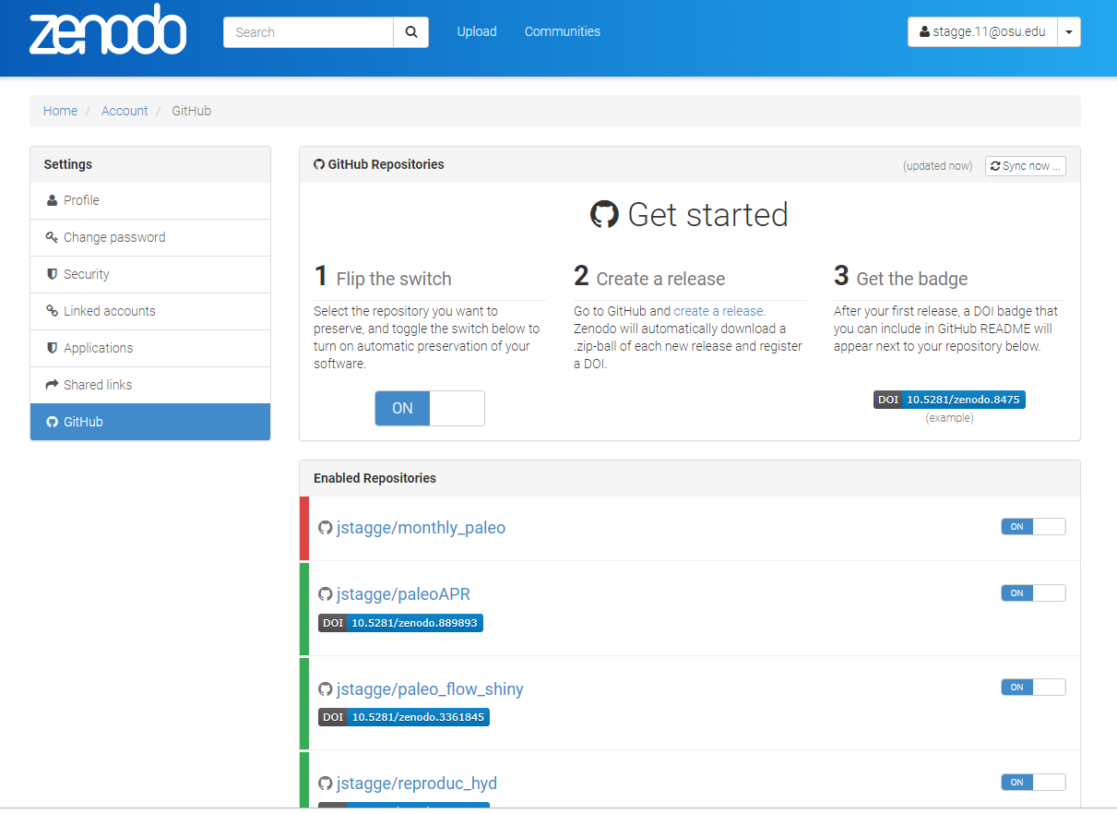
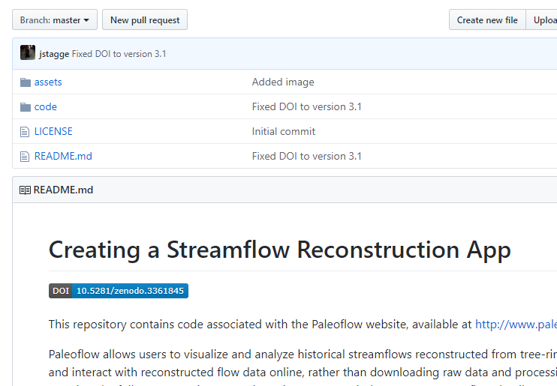
Making your code citable
Zenodo provides citeable DOI
Repository or specific version
Icon for Github

Slide 26
Warning
Dropbox

Slide 27
